Slide 1
Whither Fed Policy?
William Poole
Senior fellow, Cato institute\
And
Distinguished Scholar in Residence,
The University of Delaware
CFA Society of Virginia
Richmond
11 November 2015

Slide 2
Outline
Will begin with summary view of economy.
Then, will discuss FOMC communications strategy.
Finally, will speculate on future Fed policy.

Slide 3
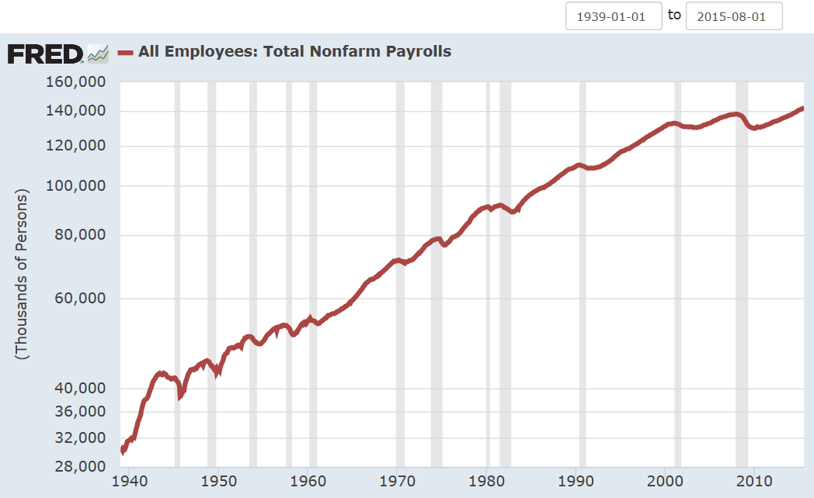
Non-Farm Employment
Ratio Scale
Employment about
10 million below full employment
Weakest Employment
Recovery Since 1945

Slide 4
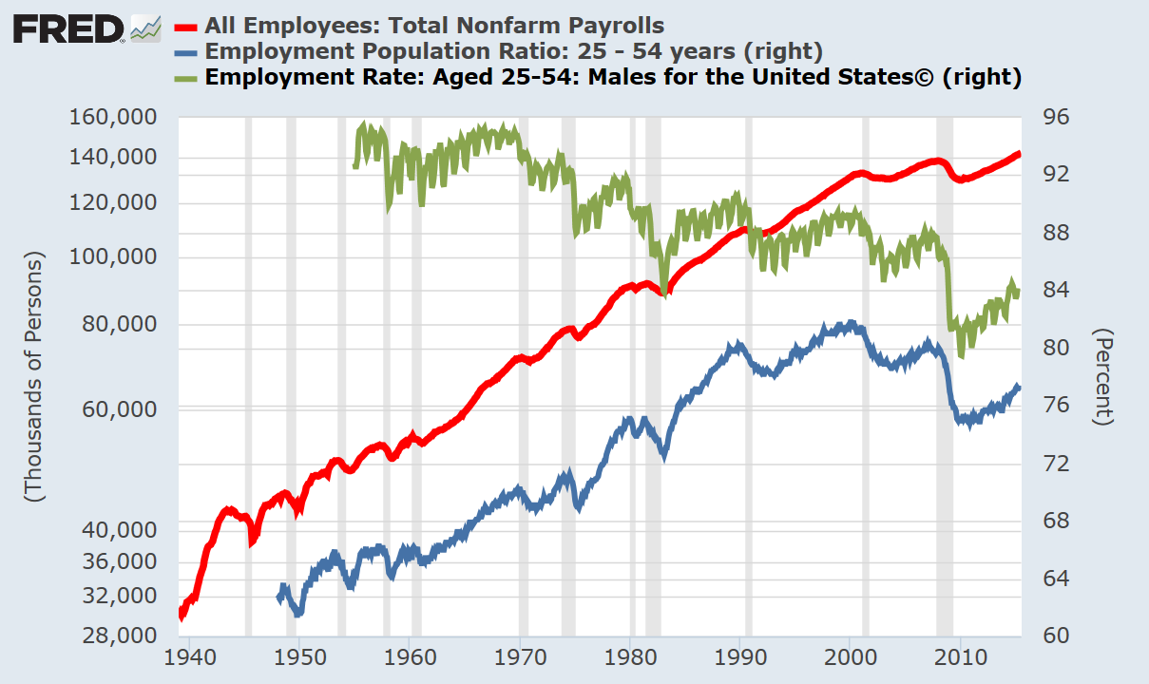
Prime-Age Employment/Population
Ratio Scale
Males 25-54 (right scale)
All workers
25-54 (right scale)
Left scale
Cyclical and secular decline in labor-force participation.

Slide 5
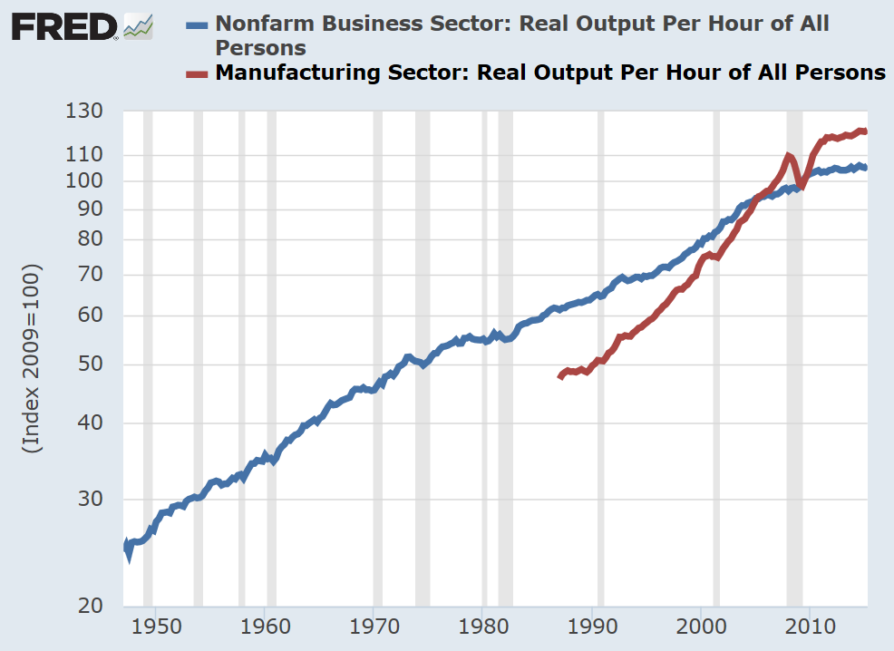
Productivity
Manufacturing productivity
growth has slowed dramatically.
Non-farm business productivity
growth almost nil.

Slide 6
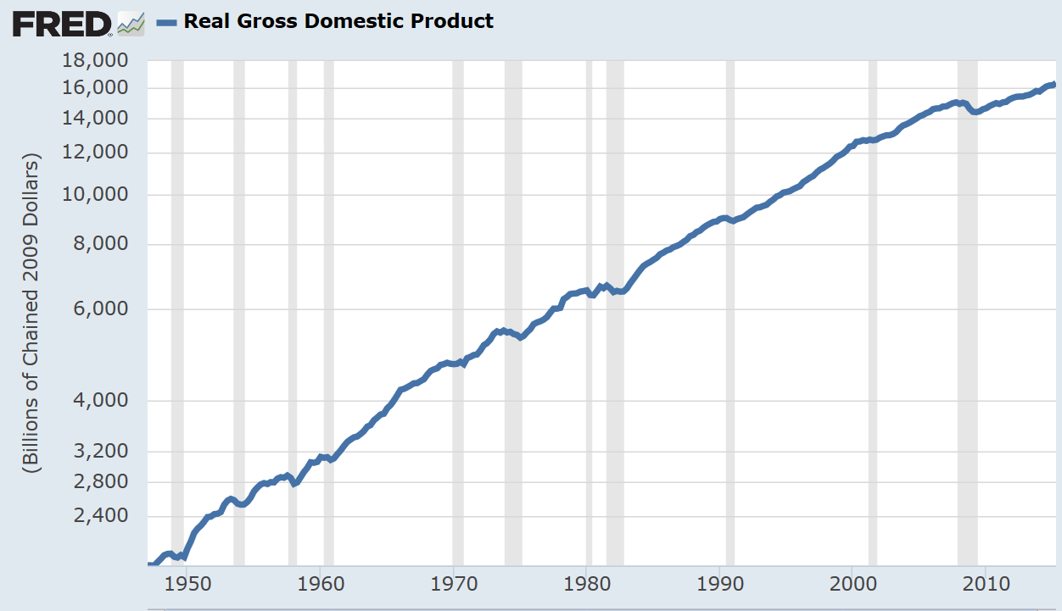
Result is Slow GDP Growth
Simple growth accounting:
%Δ GDP ≈
%Δ Employ + %Δ Prod
Real GDP
Line shows average growth
1947-2015 Q3 = 3.1%
2009 Q2 to 2015 Q3 up
2.1 % average annual rate

Slide 7
Investment Is Key
We knew residential investment would recover slowly.
But business fixed investment lagging badly despite low interest rates.

Slide 8
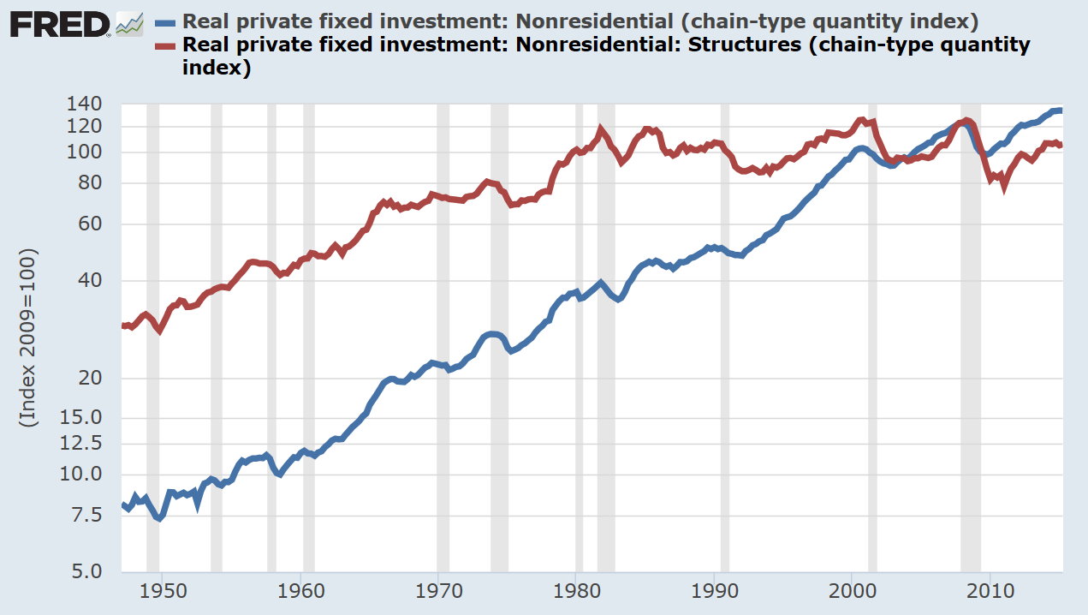
Non-residential Fixed Investment
Ratio scale
Structures Nonres index about the same
as 1980
Total non-res fixed I index
The big issue is why the
slow recovery.

Slide 9
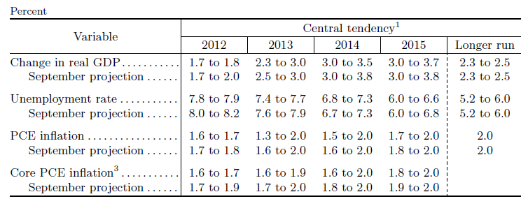
Projections, FOMC Participants
December 2012
GDP actual
2.2
1.5
1.5
2.2 (estimated)
U Rate, Actual
7.8
7.0
5.7
5.0 (estimated)

Slide 10
Is Fed on Cusp of Raising Rates?
Maybe.
Will Economy Support Higher Rates?
Real rate of interest a non-monetary phenomenon.
A cautionary example -- Japan

Slide 11
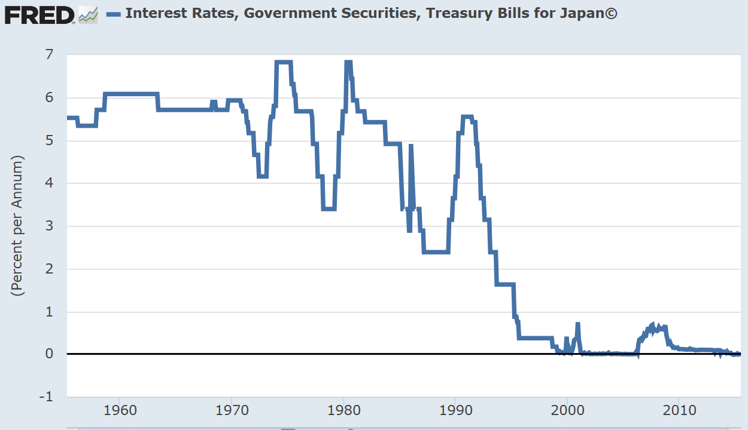
Cautionary Example-Japan
Would it have been
feasible for BOJ t0
have continued to
raise rates?
Liftoff!
02/2006
12/2000
Japan’s bubble burst a quarter century ago. Does it make any sense to believe that interest rates today still reflect that event all those years ago?

Slide 12
FOMC Guidance
Have reviewed the projections, which have not been very accurate.
Rate guidance through “dot” diagram.

Slide 13
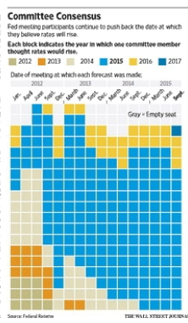
WSJ, p.A2, Sept. 18, 2015
Dot chart seemed very convenient way back when.
FOMC never considered how it would get out from under it.
FOMC has been saying since late 2012 that 2015 is likely to be the year.
Inconsistent with idea of “data dependent” policy.

Slide 14
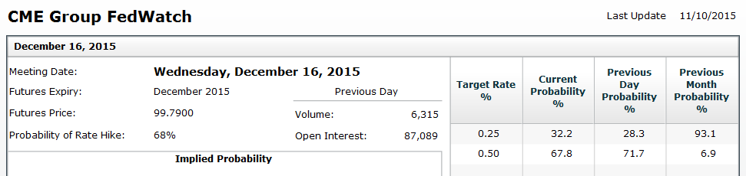
What Is Market’s Guess?
As of yesterday’s close, fed funds futures market put probability of December rate hike at 68 %.

Slide 15
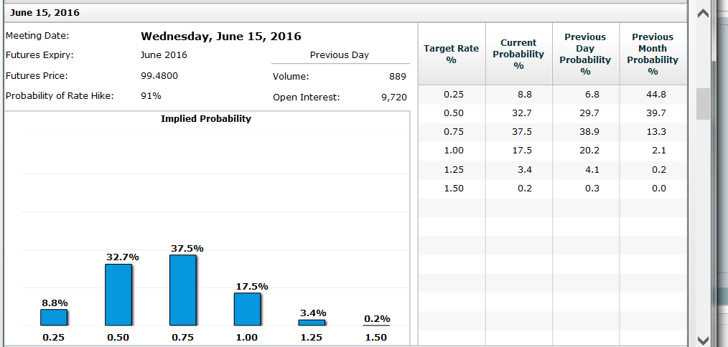
CME Fed Watch June 2016

Slide 16
FOMC Communication Failure
Even today, shortly before December FOMC meeting, market does not believe the forward guidance.
Forward guidance a mistake because things happen that change the appropriate policy action.
Difficult for FOMC to back away from prior guidance.

Slide 17
A Prior Example: FOMC Policy 2006-07
August 8, 2006: “The Federal Open Market Committee decided today to keep its target for the federal funds rate at 5-1/4 percent. … Nonetheless, the Committee judges that some inflation risks remain. The extent and timing of any additional firming that may be needed to address these risks …”
August 7, 2007: “…the Committee's predominant policy concern remains the risk that inflation will fail to moderate as expected.” [Emphasis added]

Slide 18
FOMC’s Flawed Communication Strategy
The Committee adopts language without paying adequate attention to how to exit from that language.
In 2007, FOMC forced by events to abandon language hinting that no fed funds rate cut was being contemplated.
Dot chart has created a time-dependent policy.
Will it take a surge of inflation to force the FOMC to begin liftoff?
Events plus possible Yellen speeches could abandon 2015 liftoff. Or, maybe not.

Slide 19
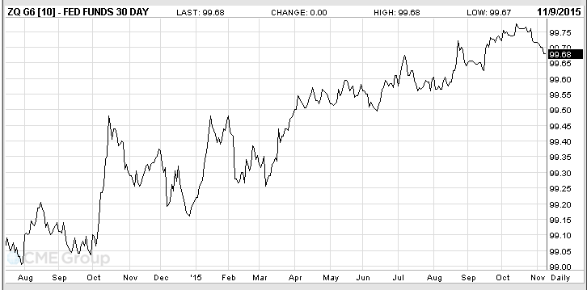
Fed funds Futures, Feb 2016 Contract
25-50 bps FOMC target range
Mkt guess based more on the economy than on what FOMC says.
50-75
Daily close
Average funds rate past 12 months = 12 bps = 99.88
2014
Source: CME Group

Slide 20
FOMC Should Explain:
What is the policy strategy (the “product”)?
How do we explain (“sell”) it and convince the market that it is a good policy?
In the face of inevitable missteps, how do we maintain credibility (brand loyalty)?
Dear FOMC: Please remember that product recalls create a problem for you and for the rest of us.

Slide 21
Poor Policy Statements
Oct 2015 statement 577 words. Bloated.
  Includes: “The Committee continues to monitor inflation developments closely.”
  When would it not?
June 2004 statement 219 words.

Slide 22
Real Interest Rate Fundamentals
In the long run, a central bank controls the rate of inflation but not real magnitudes.
This proposition accepted by all economists except for a few at the fringes.
Most economists accept the Wicksellian model of the inflation process.

Slide 23
Keys to Unlocking the Future Course of Real Interest Rates
What are the non-monetary conditions that have kept real rates so low for the past five years?
Will these conditions change over the next five years?

Slide 24
Observation 1
Low economic growth yields low real interest rates in free capital markets.
  Example 1: Japan since 1990.
  Example 2: United States in 1930s.

Slide 25
Observation 2
Poor government p0licy yields a low-growth economy.
Extreme examples:
  Cuba
  North Korea
  China before 1979
Less extreme examples:
  Soviet bloc countries before 1990
  Japan after 1990

Slide 26
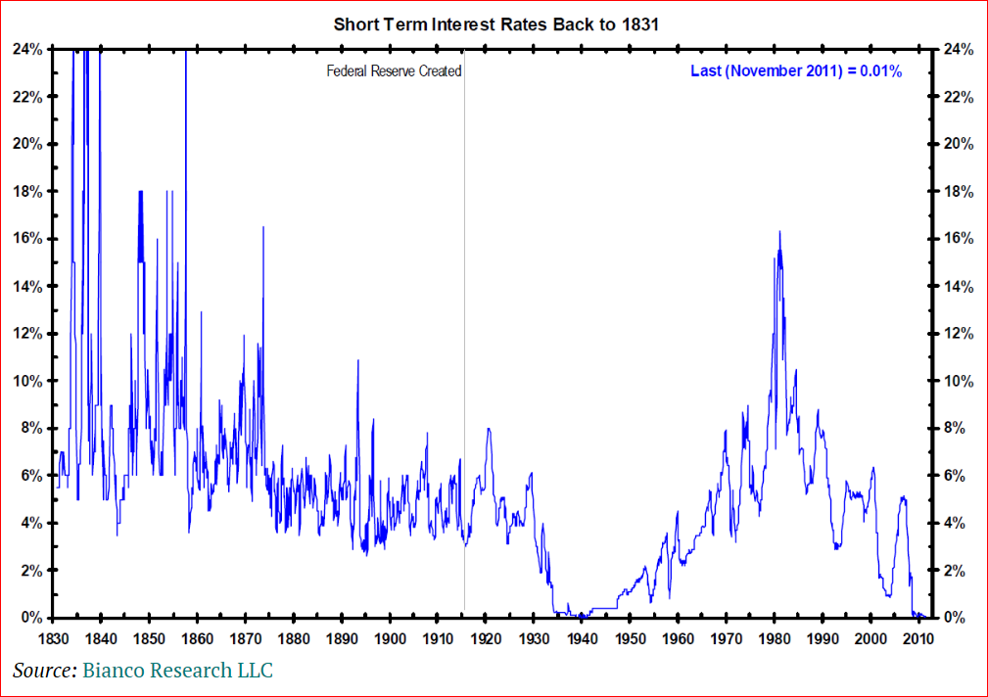
Money-Market Interest Rates
After 1831

Slide 27
Non-Monetary Disincentives
Regulatory burdens inhibit hiring and investment.
  Affordable Care Act
  Dodd-Frank
  Environmental policies block projects
  Prohibitions on tolls for bridges and highways.
Businesses fear future tax increases on capital income.
Prospects? These disincentives may remain in place for several or many more years.
If so, Fed will keep interest rates below typical levels because demand for funds for capital investment will remain depressed.

Slide 28
2016 Election Will Matter for Growth
If current policies continue, real interest rates will remain below historical levels.
Election of a Republican President likely to mean higher economic growth and higher real interest rates.
Higher real rates could appear quite quickly.
What are the odds?

Slide 29
Recap
The central bank does not control the real rate of interest.
Real magnitudes depend on real, non-monetary conditions.
Government policies that depress investment incentives also depress the real rate.
Elections matter.

Slide 30
Discussion
Questions?
Disputes?
Facts neglected?

